Slide 1
SENTIMENT ANALYSIS OF ONLINE HOTEL REVIEWS
• GISMA University of Applied Sciences
• Department of Computer & Data Sciences
• Kunal

Slide 2
1 • Introduction
Online reviews contain large amounts of unstructured data about customers’ experience.
With the increase in the number of reviews, analyzing them manually becomes increasingly difficult.
However, NLP and machine learning provide means for converting reviews into structured data for analysis.
This research is going to combine sentiment analysis and analysis of recurring aspects about hotels.
For this purpose, online hotel reviews and reviewers' ratings will be analyzed from both positive and negative perspectives.

Slide 3
Aim, Objectives & Research Questions
Aim
• Sentiment analysis of online hotel reviews using machine learning techniques, along with determination of hotel characteristics affecting customer experience.
Objectives
- Prepare and organize review data for analysis
- Create binary sentiment labels
- Utilize TF-IDF as the text representation technique
- Compare the accuracy of the Logistic Regression, Multinomial Naïve Bayes, and Random Forest classifiers
- Recognize repetitive textual features related to positive and negative sentiments
Research focus
• How effectively can ML classify hotel-review sentiment?
• Which textual features are associated with positive and negative sentiment?
• Which hotel-related factors recur across sentiment groups?

Slide 4
Related Work
Past research shows that there has been a rising trend towards the adoption of AI, NLP, and machine learning in tourism and hospitality analytics.
The aspects covered by hotel reviews range from the hotel's staff, rooms, location, breakfast, cleanliness, facilities, and cost-effectiveness of the stay at the hotel.
Classical text classification techniques remain computationally feasible when applied to large-term TF-IDF features.
Modern transformer and LLM approaches provide room for contextual modeling; nevertheless, the latter raises additional computational and reproducibility challenges.
Therefore, this dissertation considers classical approaches as the empirical foundation, with the latter being separately considered in the implementation section.

Slide 5
3 • Approach: Dataset & Preparation
Original dataset
• 515,738 observations
• 17 variables
• Hotel, reviewer, review text, ratings, dates and related information
Cleaning
• Positive_Review + Negative_Review → Review_text
• 424 observations without meaningful review text removed
• Duplicates removed using combined review text and reviewer rating
Final analytical sample
• 503,433 after duplicate removal
• 50,000 reviews selected for modelling
• 40,000 training + 10,000 testing observations
Sentiment labels
• Rating ≥ 7.0 → Positive
• Rating < 7.0 → Negative
• Final sample: 41,485 positive / 8,515 negative

Slide 6
Technical Workflow
- Hotel Reviews Data Set
- Assessment of text quality and detection of duplicates
- Sentiment binary classification depending on ratings
- Stratified sampling to achieve train/test splits (80/20)
- TF-IDF feature extraction using unigrams and bigrams
- Algorithms tested: Logistic Regression, Multinomial Naive Bayes, and Random Forest
- Cross-validation using five-folds, tuning of hyperparameters
- Evaluation of the algorithm on the independent test set
- Features analysis, analysis of words/bigrams, hotels analysis

Slide 7
Model Implementation
Logistic Regression
• Linear classifier suited to high-dimensional sparse TF-IDF
• Coefficient values support feature interpretation
Multinomial Naive Bayes
• Text-classification model based on feature probabilities
• Computationally efficient for large text datasets
Random Forest
• Ensemble of decision trees
• Provides a non-linear modelling perspective
Feature representation
• TF-IDF
• Unigrams + bigrams
• 50,000 features in training and test matrices

Slide 8
Validation & Hyperparameter Tuning
Cross-validation
• Five-fold stratified CV
• F1-score used because of class imbalance
• Logistic Regression mean F1 = 0.9283 (SD 0.0012)
• Naive Bayes mean F1 = 0.9134 (SD 0.0010)
• Random Forest mean F1 = 0.8779 (SD 0.0046)
Best configurations
• Logistic Regression: C = 1.0
• Multinomial Naive Bayes: alpha = 0.5
• Random Forest: 300 trees, max_depth = 30, min_samples_split = 2
Integrity of evaluation
• Hyperparameter tuning used training data only.
• The independent 10,000-review test set was not used for model selection.

Slide 9
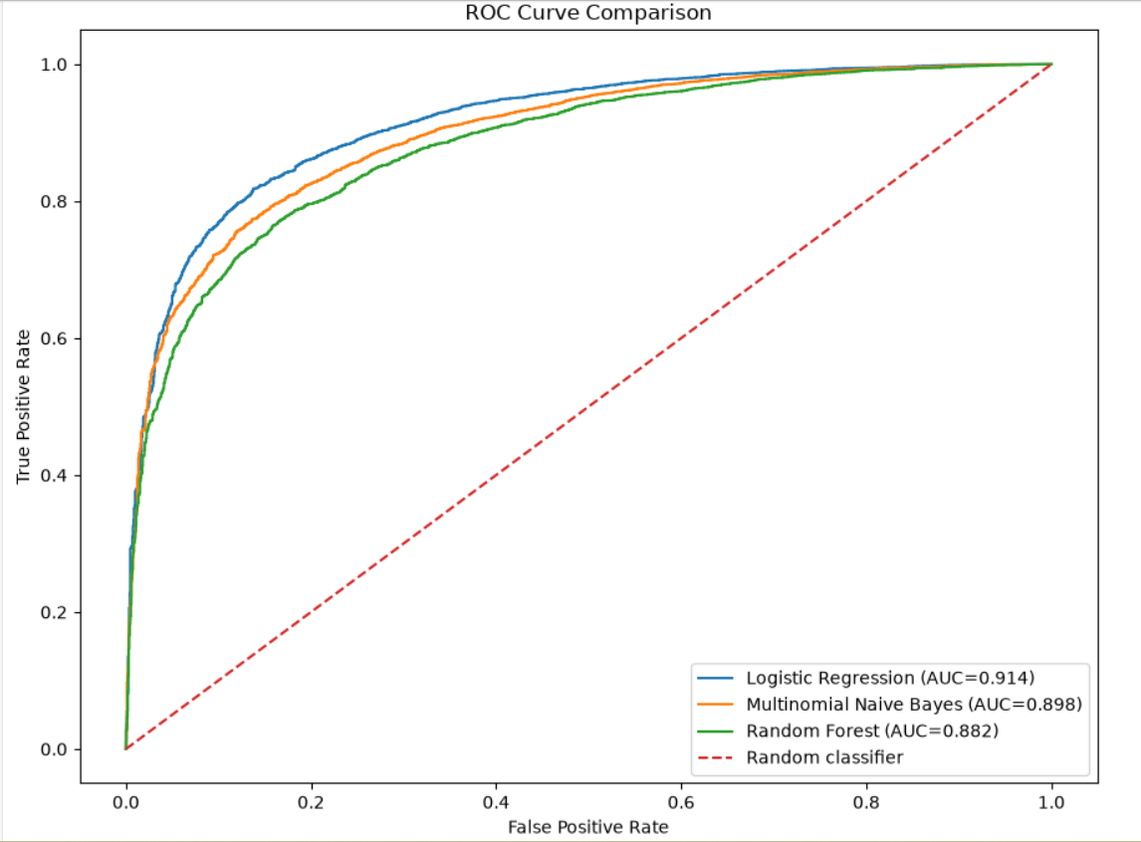
Evaluation & Results
Logistic Regression
• Accuracy: 88.29%
• Precision: 89.25%
• Recall: 97.65%
• F1: 0.9326
• ROC-AUC: 0.9143
Multinomial Naive Bayes
• Accuracy: 87.17%
• Precision: 87.96%
• Recall: 97.94%
• F1: 0.9268
• ROC-AUC: 0.8982
Random Forest
• Accuracy: 81.67%
• Precision: 94.23%
• Recall: 82.99%
• F1: 0.8825
• ROC-AUC: 0.8821

Slide 10
Class-Level Performance
Logistic Regression
• Positive recall: 0.98
• Negative recall: 0.43
• Negative F1: 0.55
Multinomial Naive Bayes
• Positive recall: 0.98
• Negative recall: 0.35
• Negative F1: 0.48
Random Forest
• Positive recall: 0.83
• Negative recall: 0.75
• Negative F1: 0.58
Interpretation
• The sentiment classes are strongly imbalanced.
• The models behave differently for minority negative reviews.
• Precision, recall and F1 provide additional information beyond accuracy.

Slide 11
Textual & Hotel-Related Factors
Positive-associated terms
• Examples reported in the thesis include: excellent, great, comfortable, helpful.
Negative-associated terms
• Examples include: poor, rude, dirty, bad, uncomfortable.
Recurring hotel factors
• Staff & Service
• Room
• Location
• Breakfast
• Comfort
• Cleanliness
• Facilities
• Value for Money
Important interpretation
• Factors occur in both positive and negative reviews.
• Frequency indicates textual association, not causal effect.

Slide 12
Research Contribution
Conducts an empirical study comparing the performance of three traditional classifiers based on a consistent TF-IDF representation.
Uses a training/testing scheme that includes stratified cross-validation and independent testing.
Examines the link between sentiment classification and customer experience text analysis.
Proposes a computational workflow based on an openly accessible collection of hotel reviews.
Illustrates the significance of class evaluation when the number of positive and negative reviews is imbalanced.
GISMA University of Applied Sciences • Department of Computer & Data Sciences • 13

Slide 13
Limitations
• The sentiment tags are based on the ratings of the reviewers and not on the sentiment tagging of the texts linguistically.
• It is secondary data, as the original data collection process was out of the researcher’s control.
• European hotel review data cannot be generalized to all users across the globe.
• There is no comprehensive comparison possible between TF-IDF, traditional machine learning models, and transformers.
• There could be some simplification involved in the combining of the review text.
• Textual relations may be discovered through factor analysis, yet causality cannot be claimed.
• Numerical ratings and review texts may capture different aspects of the user experience.

Slide 14
Future Research
Better labels
• Use manually annotated sentiment rather than relying only on rating-derived labels.
Advanced NLP
• Use contextual language models / transformer architectures for richer semantic representation.
Aspect-based analysis
• Measure hotel factors separately and improve factor identification beyond keyword counts.
Broader validation
• Test across datasets, regions and review platforms.
Model robustness
• Further investigate class imbalance and minority-class performance.

Slide 15
Conclusion
• Machine-learning algorithms based on traditional TF-IDF demonstrate great predictive power for the task of classifying hotel reviews carried out within this paper.
• Logistic Regression produces an F1-score of 0.9326 and an ROC-AUC of 0.9143 for the final test data.
• The paper highlights recurring elements of the customers’ experience such as staff/Service, Room, Location, Breakfast, Comfort, Cleanliness, Facilities, and Value for Money.
• Combining sentiment classification with textual factor analysis contributes to the broader picture of the information conveyed by hotel reviews.
• The results need to be considered in the context of the data used in the experiment and its methodology.

Slide 16
Conclusion
• Machine-learning algorithms based on traditional TF-IDF demonstrate great predictive power for the task of classifying hotel reviews carried out within this paper.
• Logistic Regression produces an F1-score of 0.9326 and an ROC-AUC of 0.9143 for the final test data.
• The paper highlights recurring elements of the customers’ experience such as staff/Service, Room, Location, Breakfast, Comfort, Cleanliness, Facilities, and Value for Money.
• Combining sentiment classification with textual factor analysis contributes to the broader picture of the information conveyed by hotel reviews.
• The results need to be considered in the context of the data used in the experiment and its methodology.

Slide 17
THANK YOU
Questions & Discussion
Sentiment Analysis of Online Hotel Reviews
GISMA University of Applied Sciences • Department of Computer & Data Sciences • 18

